Slide 1
Digital Futures in Assessment: Utilising Diagnostic Computer-Marked Assessment to Support Student Learning
Presented by
  Amanda Milambo
  Priti Lodhia
  Aravindi Samarakkody

Slide 2
Agenda
Context
Session focus
Presentation
Discussion
Reflection

Slide 3
Context
This session disseminates findings from an internally funded Small Teaching Action Research (STAR) project focused on innovation in teaching, assessment, and digital learning.
THE PROBLEM
Unit rate calculations are a fundamental QS competency
↓
OUR RESPONSE
Diagnostic marking tool to automate aspects of judgement + generate feedback
↓
WHAT WE DISCOVERED
Potential beyond the case study:
Critical analysis | Professionalism | AI literacy | Professional scepticism

Slide 4
Project Journey
PILOT PHASE
REFLECTION PHASE
IMPLEMENTATION PHASE

Slide 5
TODAY’S SESSION
Exploring:
How can CBA support competency & professional enquiry?
How can diagnostic feedback support student learning?
How do we need to adapt pedagogic approaches for AI?
Presentation
Focus group discussion
Post focus group reflection

Slide 6
Rationale
Improve student experience and understanding of producing accurate unit rates
Develop students:
  Critical analysis skills
  Enquiry skills
  Professional judgement
Improve marking and moderation process

Slide 7
The Tool

Slide 8
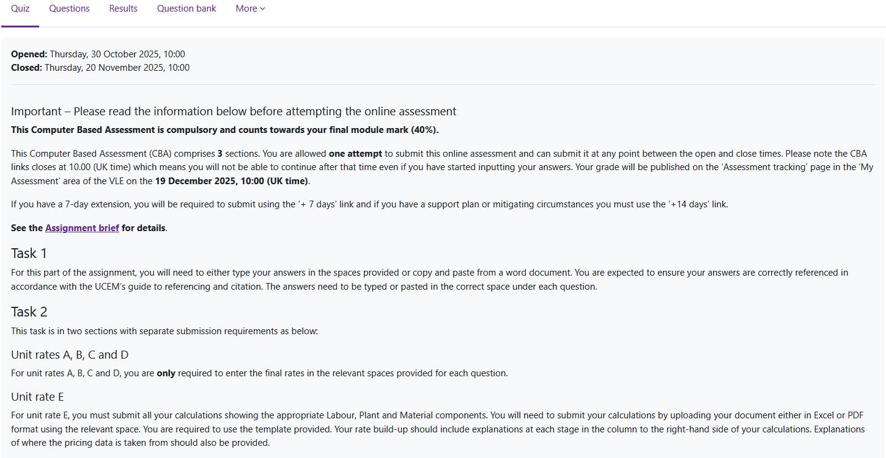

Slide 9
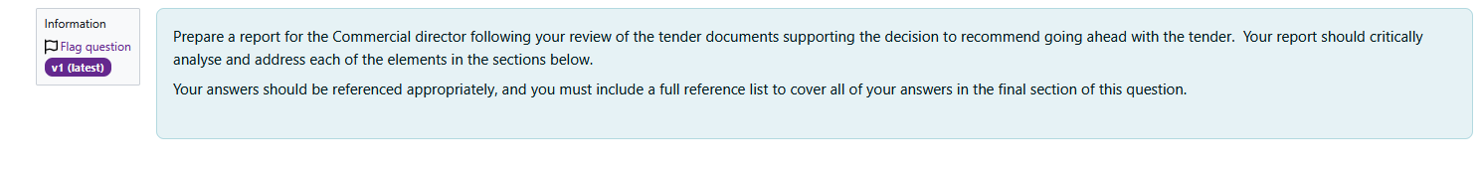
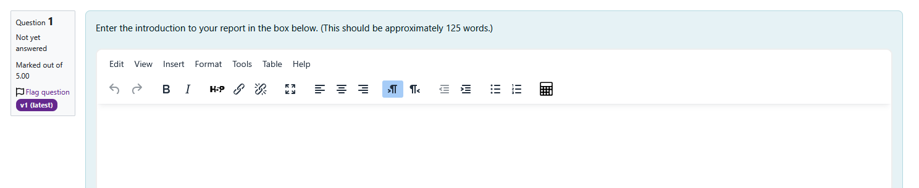
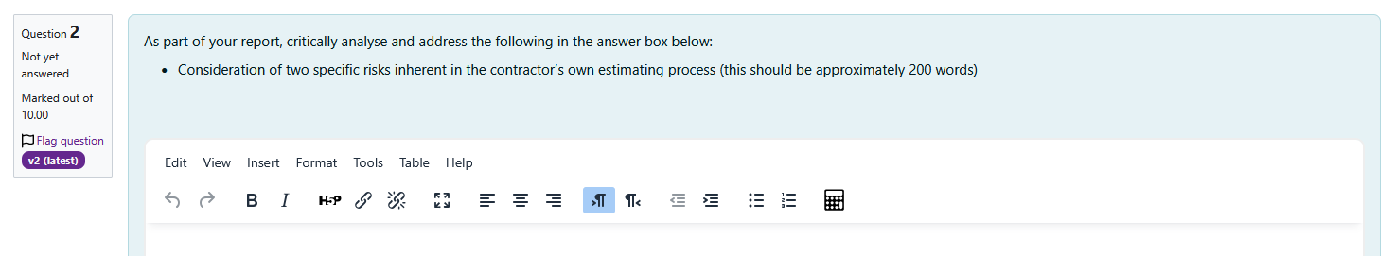
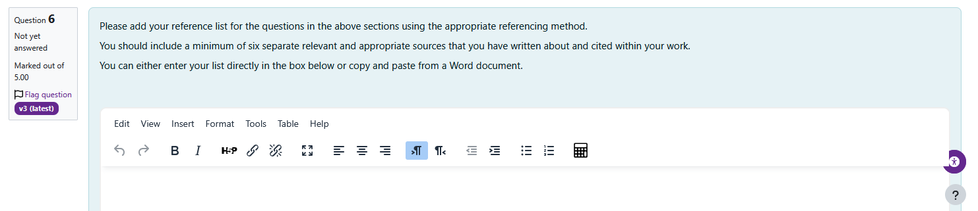

Slide 10
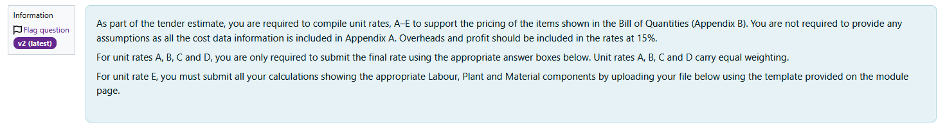

Slide 11
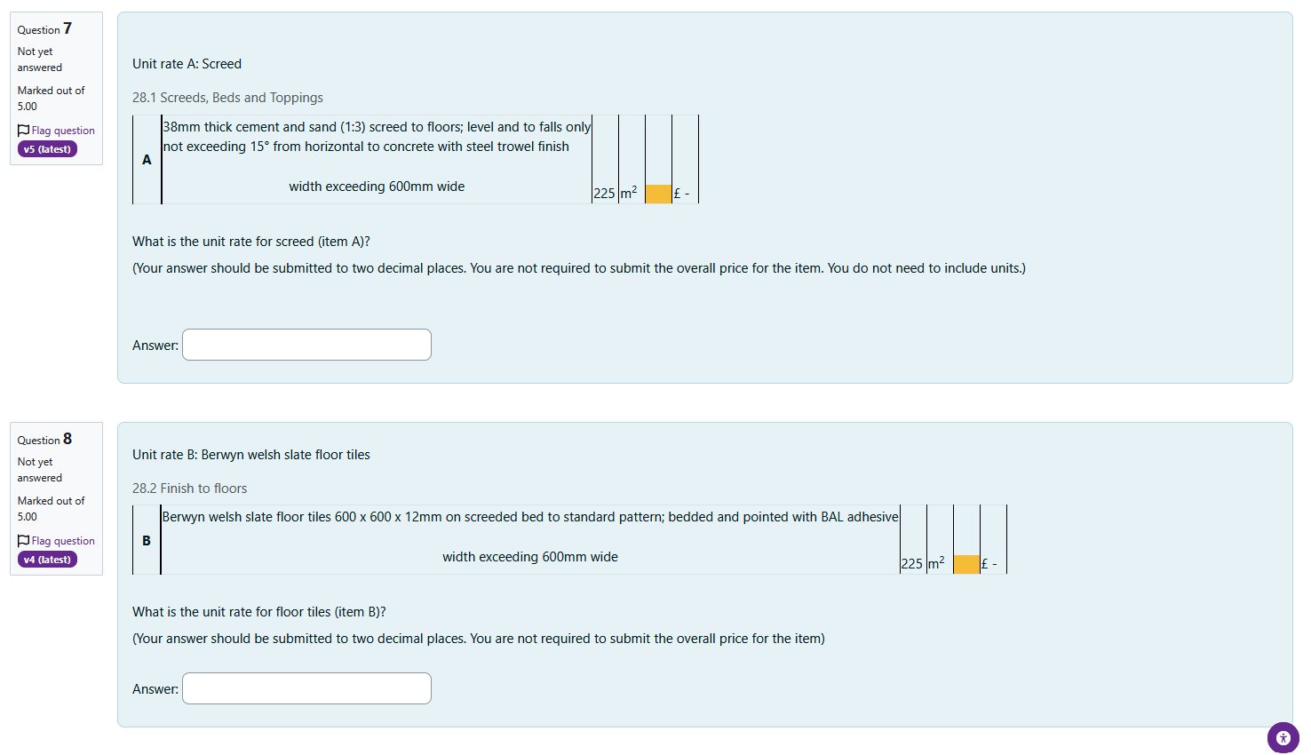

Slide 12
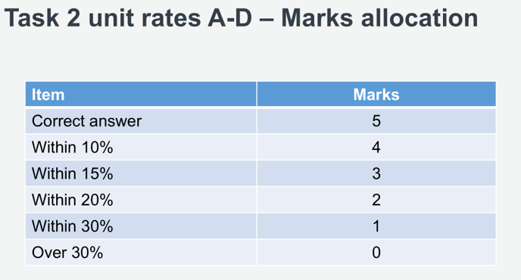

Slide 13
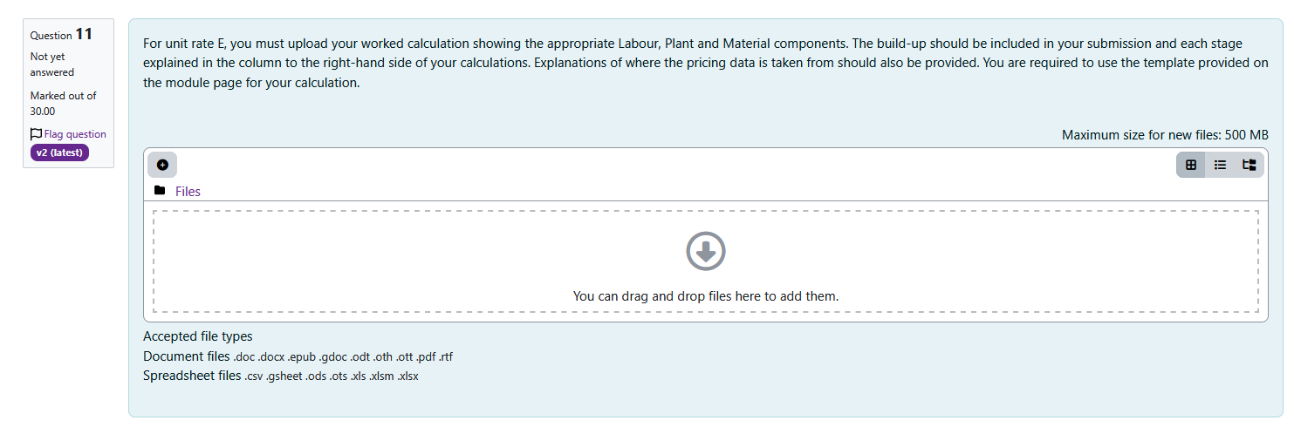

Slide 14
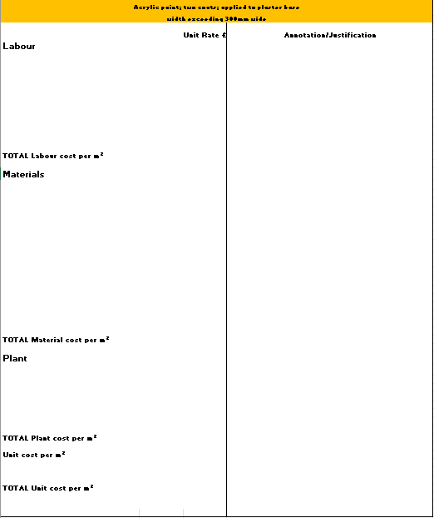

Slide 15
Results

Slide 16
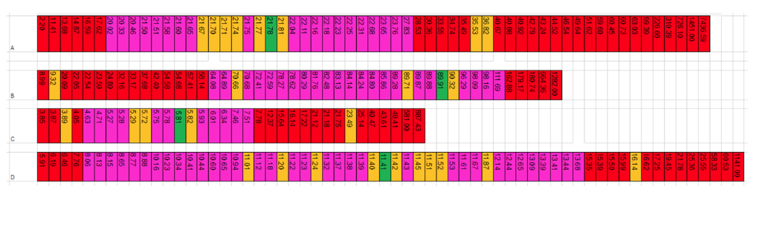
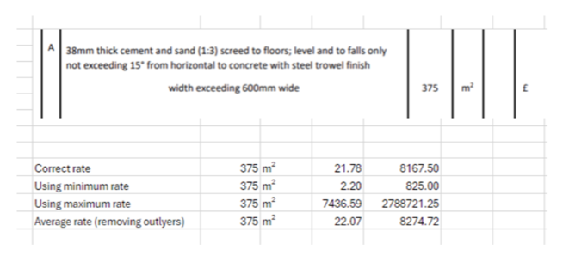
Feedback

Slide 17
Case specific benefits
Non-case specific benefits
Enhanced assessment validity and student competence
Improved feedback and student learning
Data-Driven quality enhancement
Operational efficiency and consistency
Building skills of critical analysis and professionalism
Supports the development of AI literacy
Supports the development of students' professional scepticism

Slide 18
Discussion

Slide 19
Focus group questions
How might diagnostic computer-based assessment change the way students learn, and what aspects of learning might it fail to support effectively?
Where do you see the boundaries between what can be effectively supported by diagnostic computer-based assessment and what still requires human academic judgement?
What unintended learning behaviours or assessment strategies might this type of diagnostic assessment encourage, and how could educators address them?
If this approach were adopted more widely, what would you change, add, or redesign to maximise its educational value? (Where do you see the opportunity to use something similar in your practice.)
If graduates are increasingly expected to work alongside AI systems, how might diagnostic assessment develop their competency in exercising professional judgement?

Slide 20
Thank you

